Slide 1
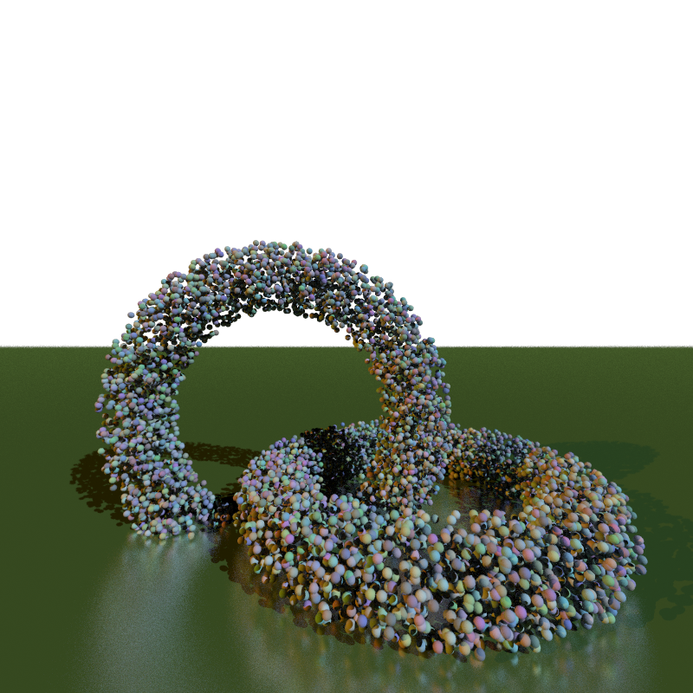
A Ray-Tracing Accelerator for Ray-Triangle Intersections
Members: Yugal Kithany, David Phillips, Jin Jiang

Slide 2
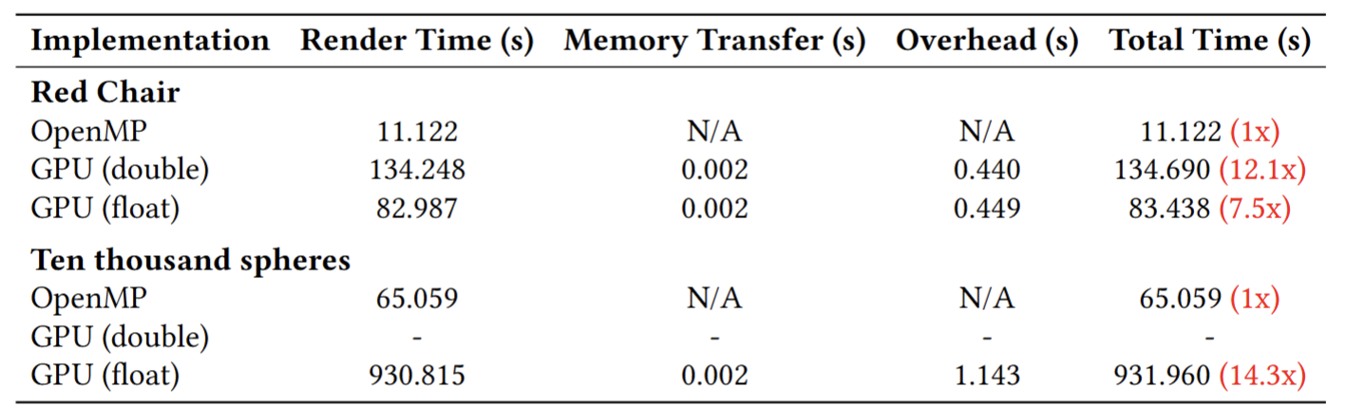
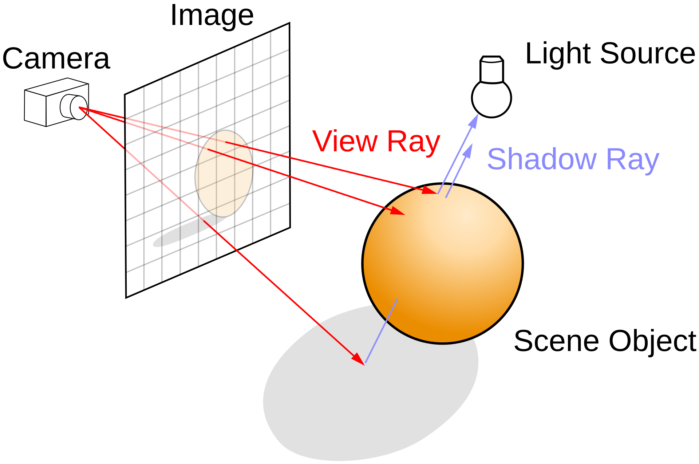
Motivation: Specialized Hardware Needed!
For a 1920x1080 screen with a 100,000 triangle meshes scene, a total of 2.07E11 intersections have to be calculated, not counting any reflection, refraction, shadow ray, Global illumination, or BVH traversal accelerations.

Slide 3
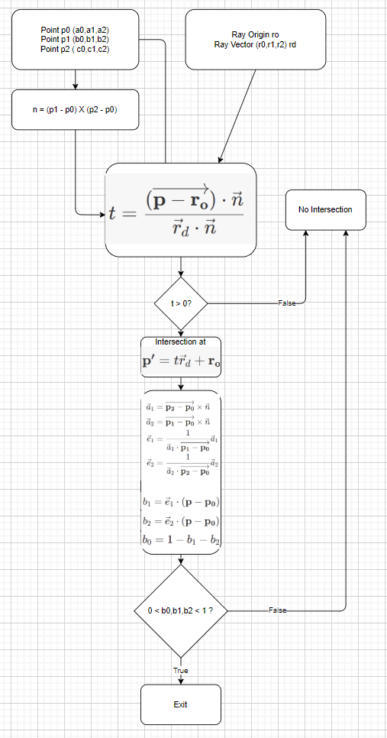
Methodology: Ray-Triangle
Intersection Algorithm in Hardware
Check if the ray intersects with the plane which the triangle lies on.
If intersects, finds the barycentric coordinates of this intersection point.
If all coordinates are between 0 and 1, it means the intersection point is within the triangle.

Slide 4
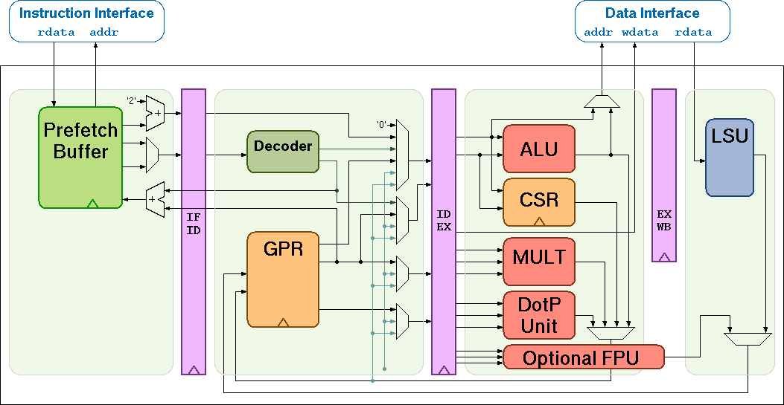
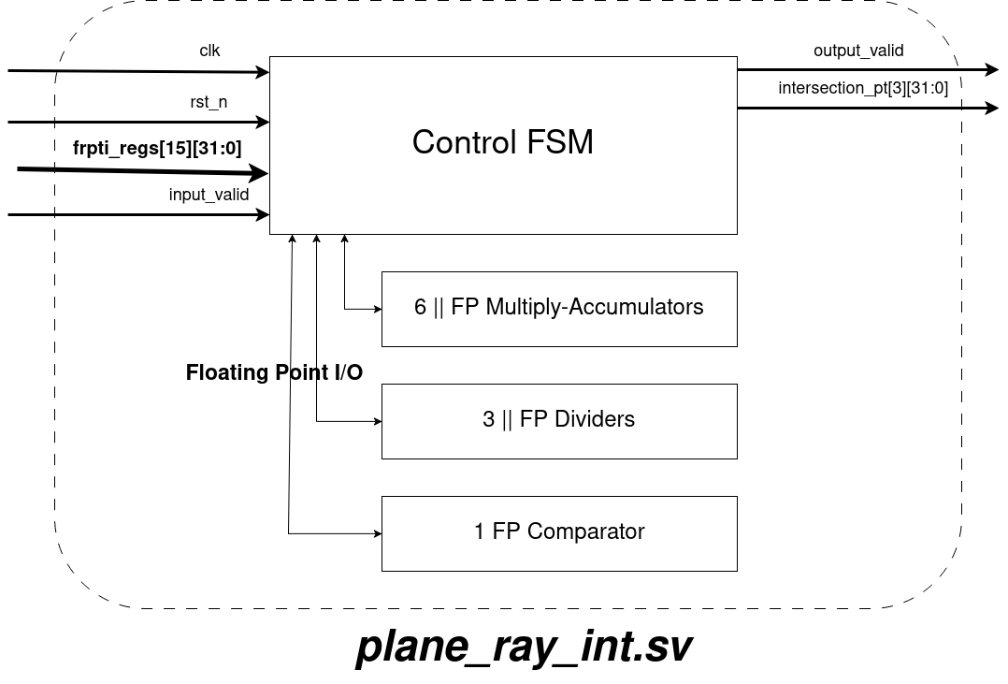
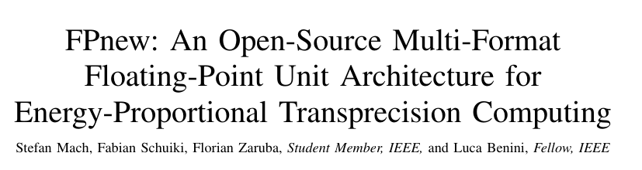
RTL Implementation
FOSS RI5CY-Core

Slide 5
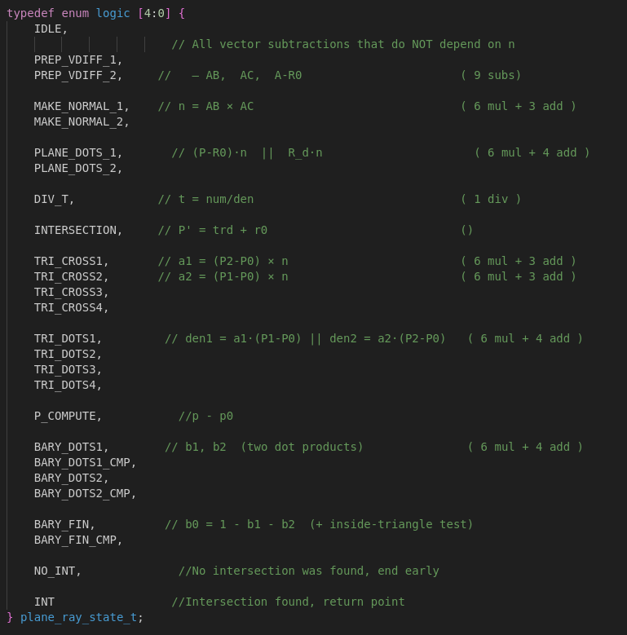
FSM Design
26 Linear Stages
Parallelize FLOP jobs as much as possible within stages while obeying dependencies
FP hardware config (6 FMA, 3 DIV, 1 CMP) chosen for common case rather than worse case to keep area/power reasonable
Return NO_INT as soon as possible to avoid extraneous execution

Slide 6
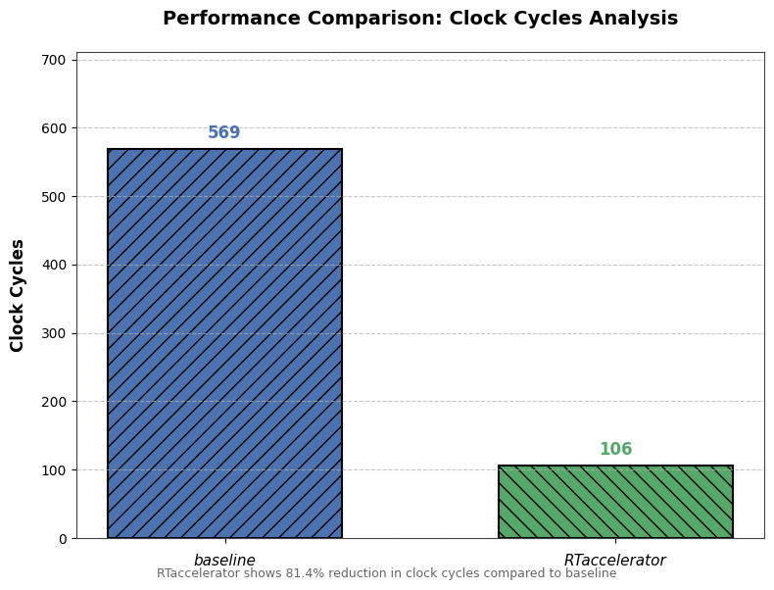
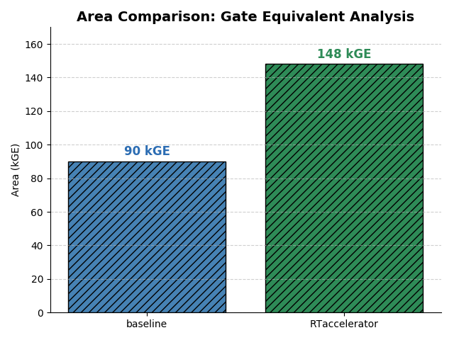
Intermediary Results/Graphs
Remaining Work: Integrate Module With RI5CY Core
Notes:
Total Area (kGE) = (Number of Multiplies × 5.5) + (Number of Adders × 4.0) + (Number of Dividers × 11.0) + (Number of FFs × 0.01) + Control Overhead
Total Area (kGE) = (4 × 5.5) + (3 × 4.0) + (2 × 11.0) + (300 × 0.01) + 0.5
Using https://github.com/ucb-bar/berkeley-hardfloat and other resources. “Design and Analysis of Floating Point Units for Embedded Processors”
Baseline paper gives 90k estimate.
Will use Yosys to get accurate area estimates

Slide 7
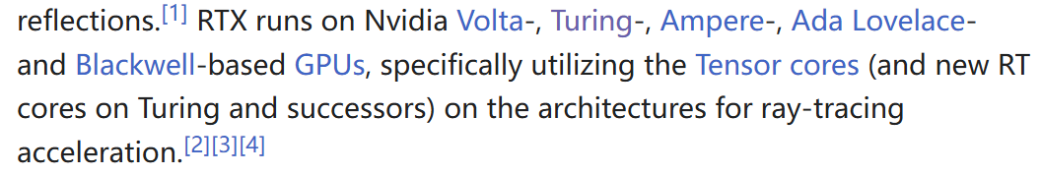
Related Works
Nvidia has a RT core, but not too much info could be found on it.
The actual algorithm for the ray-triangle intersection are from here: The ray-tracing gem book: https://www.realtimerendering.com/raytracinggems/rtg/index.html The CS 418 class website: https://cs418.cs.illinois.edu/website/text/rays.html#ray-sphere-intersection

Slide 8
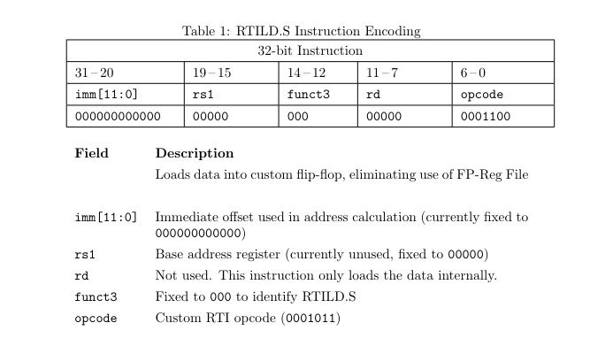
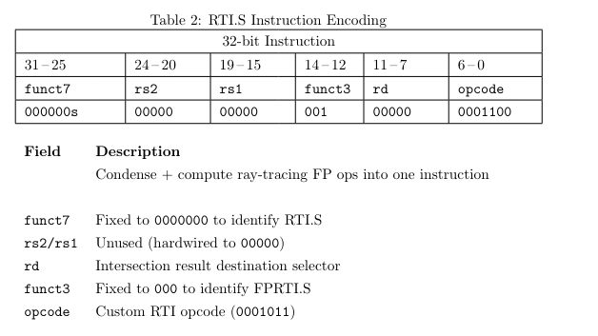
Methodology 2: RTI.S & RTILD.S

